Slide 1


Energy Generation and Uses: Policy and Economics in Central Europe
Centre of Information and Library Services, University of Economics, Prague
20. 11. 2017
Practical aspects of waste heat utilization in the Czech Republic: How to link supply with demand?
Jan Brabec - National centre for energy savings; Faculty of Humanities, Charles University, Prague

Slide 2
Why is waste heat on the brink of interest?
Waste heat: cheap and ecological energy source
Unused potential
  Little attention paid to waste heat
  Data about waste heat sources not available
  High transaction costs
  Regulatory barriers
  (e.g.,third party access, possibility of losing licence/subsidy)
            CE HEAT project:
Goal of increased waste heat utilization

Slide 3
CE-HEAT project
Project partners:
  Jana Evangelista Purkyně University in Ústí nad Labem
  National centre for energy savings
  Partners from 5 European countries(Germany, Croatia, Slovenia, Austria, Poland)
Duration of the project: 1/6/2016 – 31/5/2019
http://facebookcom/CEHEAT
https://twitter.com/CE_HEAT
https://www.linkedin.com/company/ce-heat

Slide 4
Specific CE-HEAT goals:
  Mapping of waste heat sources
  Creating a manual for investors
    Linking supply and demand
  Changes in regulatory conditions
  Case study: Constructing of a local heat supply system

Slide 5
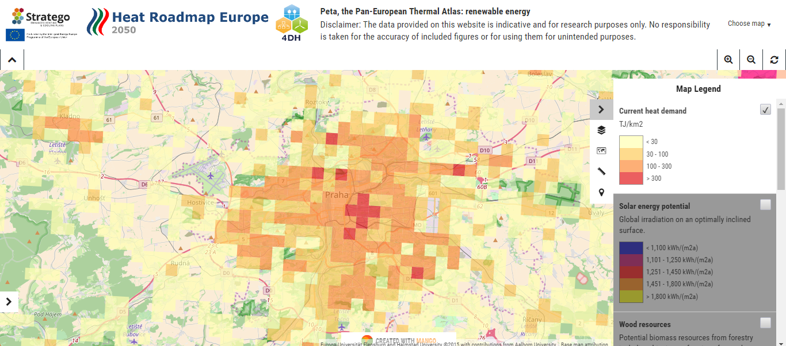
Mapping as a part of stratego project
Source: Application of Pan-European Thermal Atlas (http://stratego-project.eu/ )

Slide 6
Czech steel industry?
Specific activities of CE-HEAT project:
Effort to increase efficiency
Wire rod mill
Heat from a cooling bed => electrical energy?
Cooling of various products
Waste heat: 300 - 900°C, depending on various aspects

Slide 7
Broader context: Readiness for infrastructural projects
Broader context:
  Share of Czech citizens connected to central heat supply system: 38.1 %
  (1.5 milion households)
  Number of sources over 5 MWth of power: 1 800
  31 % of fuels in the Czech Republic used for heating
  (68 % of which is coal and wood used by households)
  57 % of heat supplied by sources over 300 MWth
  75 % heat is produced by cogeneration
Zdroj: VŠB, ČSÚ

Slide 8
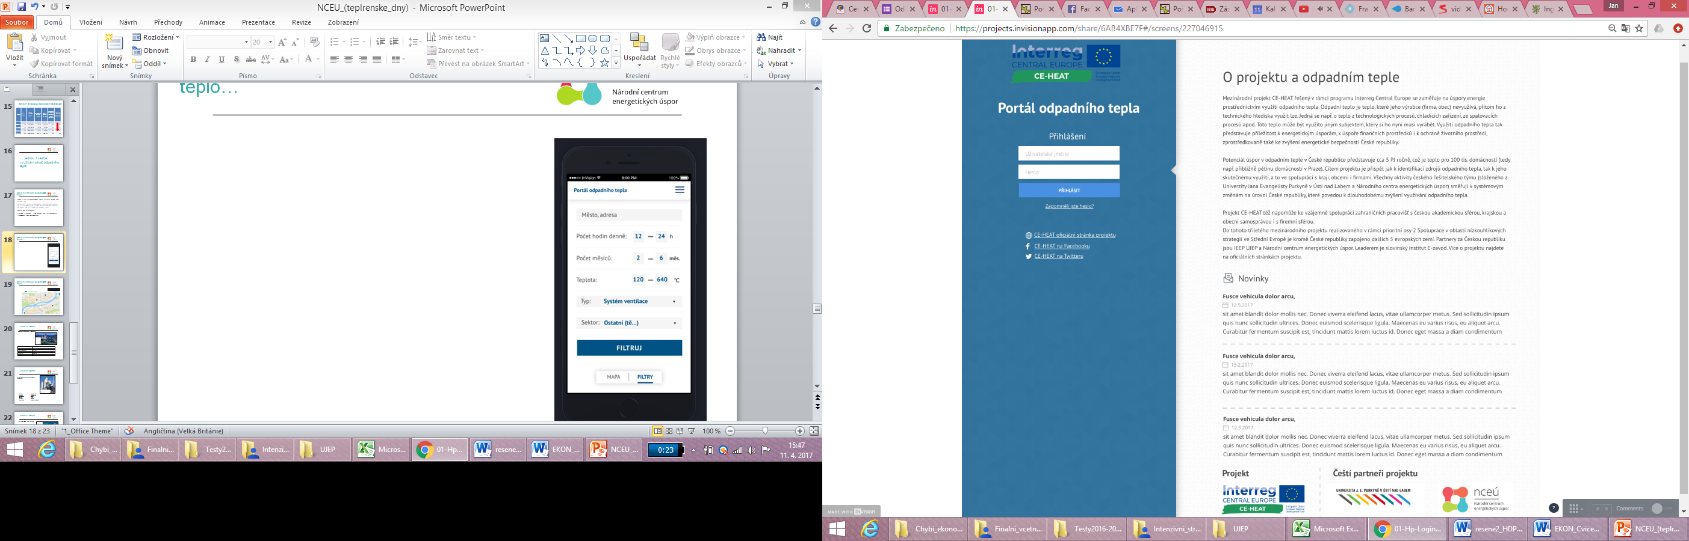
Webportal for public administration
http://www.portalodpadnihotepla.cz/

Slide 9
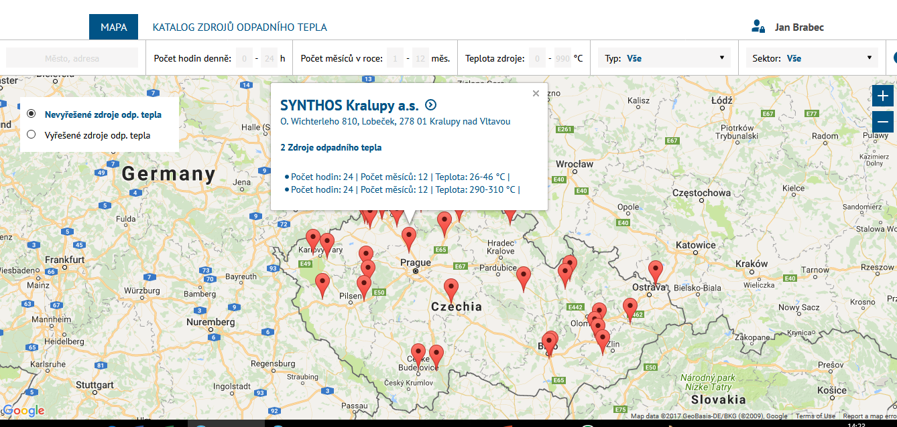
Příklad aplikace pro veřejnou správu

Slide 10
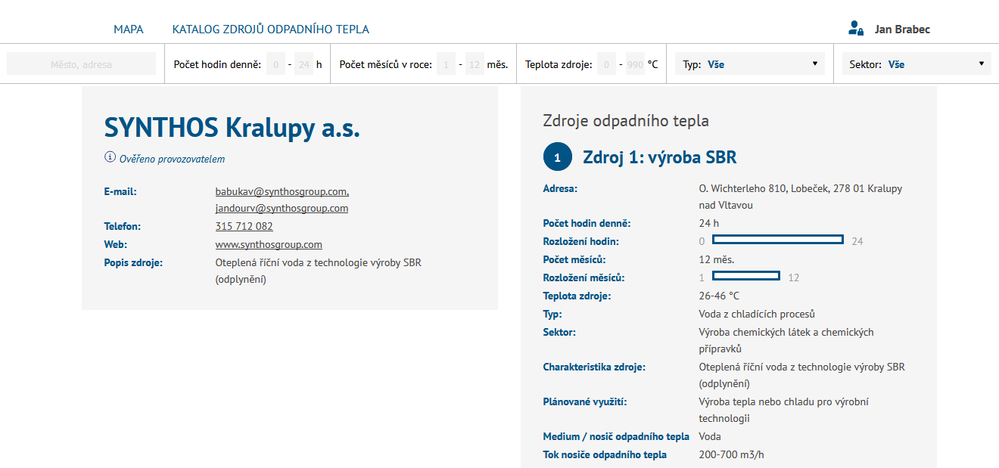

Slide 11
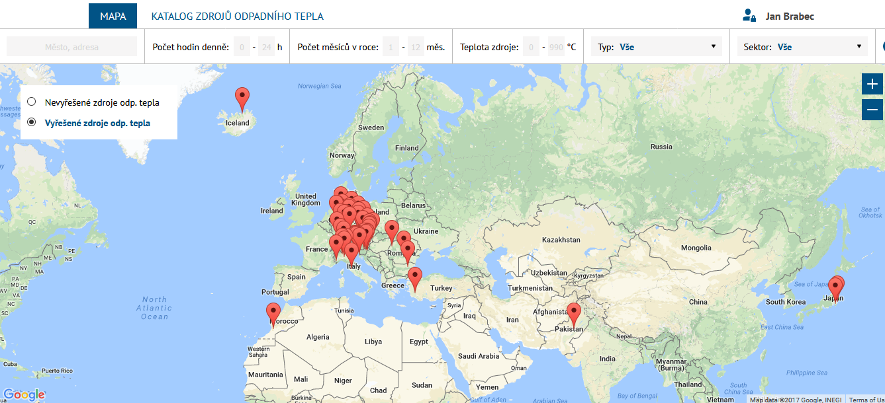

Slide 12
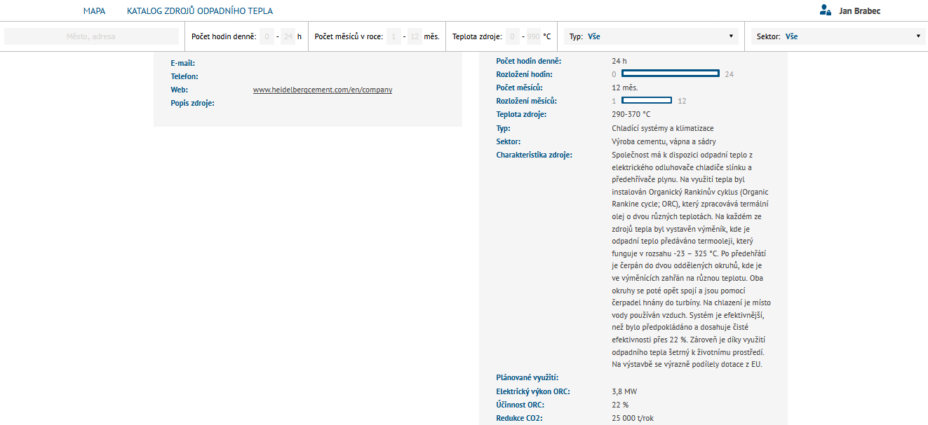

Slide 13
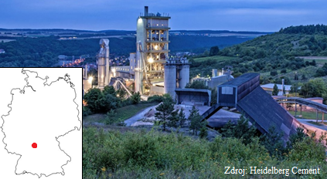
Cement works – Lengfurt (Germany)
Waste heat is generated during a proces of clinker cooling. Hot steam are used in an Organic Rankine cycle
The company covers 12% of annual energy consumption
Input temperature | 275 °C
Heat output of the heat exchanger | 12.8 MW
Electrical power of ORC | 1.05 MW
Overall energy savings | 7 200 MWh
CO₂ reduction | 7 000 t/year
Total costs | 4 000 000 €

Slide 14
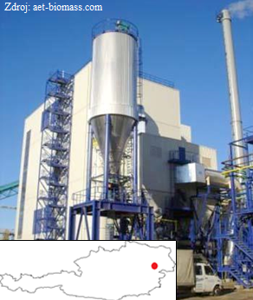
Manufacture of compact plates – Neudörfl (Austria)
In 2013, Neudörfl and Bad Sauerbrunn have switched from fossil fuels to central heat supply systém
Waste heat created during processing of plates in a nearby factory. The heat is used for provision of hot water and heating
Heat production | 13 000 MWh/year
Planned production | 24 000 MWh/year
Operating hours | 8 493/year
Grid length | 12 km
CO₂ reduction | 6 900 t/year
Total costs | 7 200 000 €

Slide 15
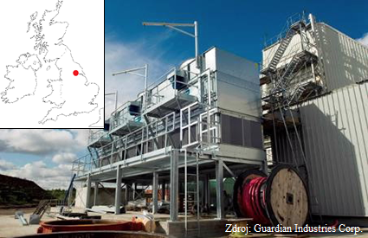
Glassworks – Goole (Great Britain)
Heat from furnaces utilized in Organic Rankine Cycle (continuous)
Waste heat utilization covers half of the electric energy required to run the production line
Temperature in the furnace | 1 600 °C
Energy savings | Half of the energy on the production line
CO₂ reduction | 6 000 t/year
Total investment | 4 950 000 €

Slide 16
Conclusions
Goal of the project is to utilize the potential of waste heat and incorporate it into current a new spatial planning systems and energy management
Regulatory changes and initiation of a support scheme
The Czech Republic: well prepared for waste heat utilization in terms of infrastructure

Slide 17
Thank you for your attention!
Jan Brabec
Národní centrum energetických úspor
Faculty of Humanities, Charles University
(jan.brabec@nceu.cz)

